Slide 1


Internationalization with @angular/localize
Pandiyan Murugan

Slide 2
Why?
Internationalization is the process of designing and preparing your app to be usable in different languages.
Localization is the process of translating your internationalized app into specific languages for particular locales.

Slide 3
Internalization in angular
Angular simplifies the following aspects of internationalization
Displaying dates, numbers, percentages, and currencies in a local format.
Preparing text in component templates for translation.
Handling plural forms of words.
Handling alternative text.
https://angular.io/guide/i18n

Slide 4
Popular plugins
Popular plugins for il8n(Internationalization) are
@ngx-translate/core
angular-translate

Slide 5
How to add il8n?
The angular CLI supports the option to add the localize option in our project
ng add @angular/localize
Once we have run the above command in our project, the CLI will add necessary dependencies to the project.
And it adds following the entry into the polyfills.ts
import '@angular/localize/init';

Slide 6

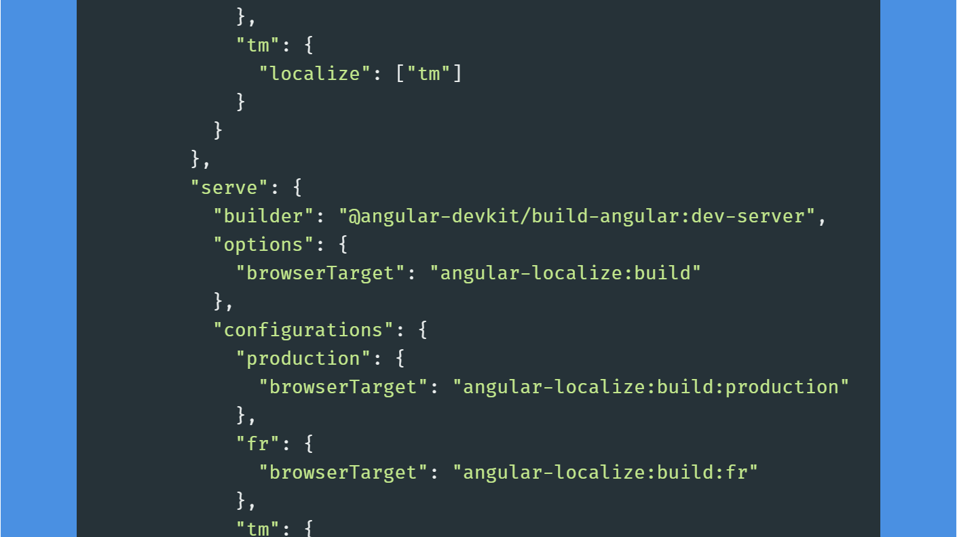

Slide 7
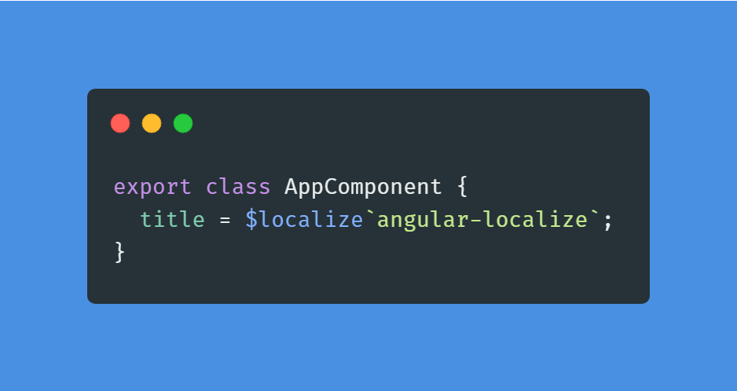
The angular package provides an option called $localize which can be used in the component

Slide 8

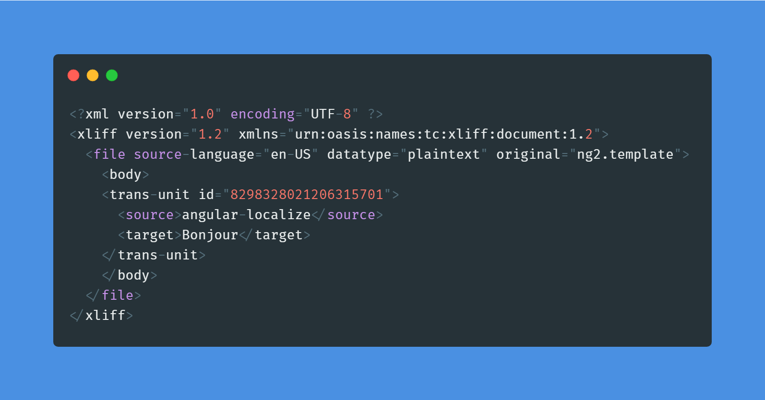

Slide 9
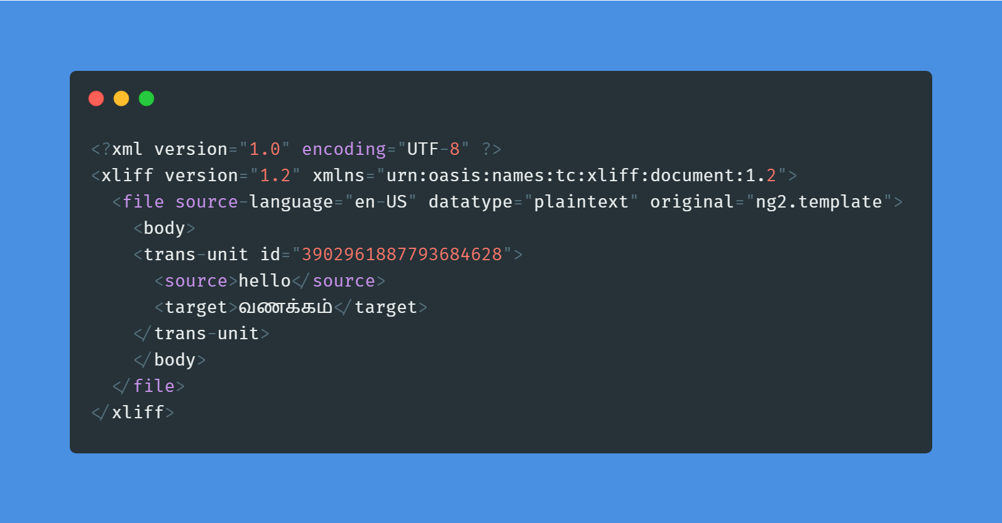

Slide 10
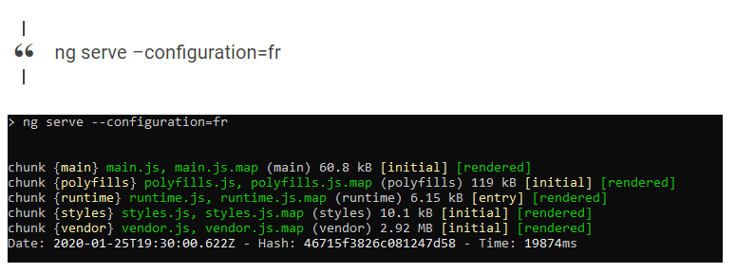

Slide 11
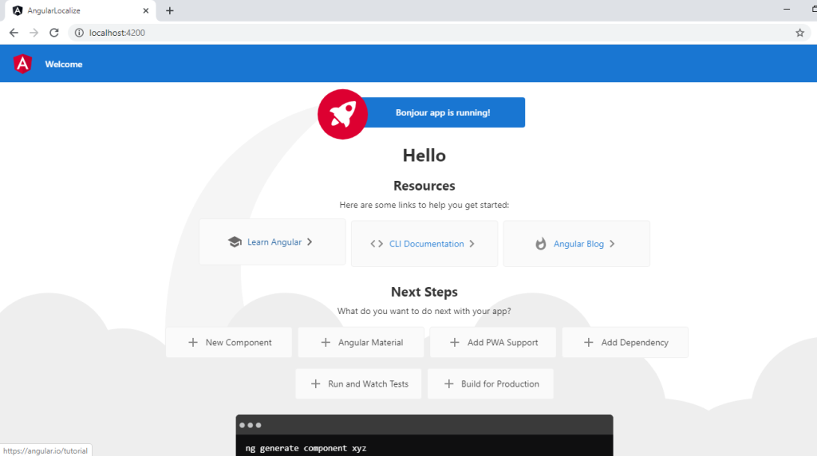

Slide 12
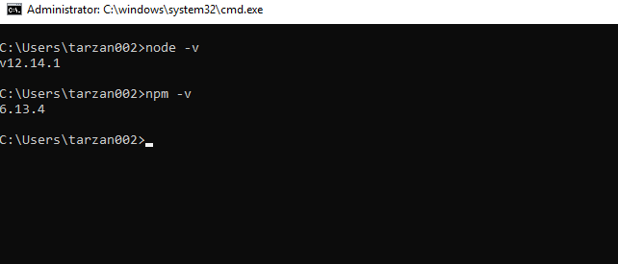

Slide 13


What’s Next?
Efficient User
Click the Subscribe button
Follow us
And show us your continuous support.
https://efficientuser.com
https://twitter.com/efficientuser

